Slide 1

Airbnb’s in New York City
John D’Aiutolo
Michael Lohr
Ken Talibdjanov

Slide 2


Topics
Where we found our data
Questions we’ll be answering through analysis of our dataset
Hypothesis
Data analysis
Conclusion

Slide 3



Where did we find our data?

Slide 4


Inside Airbnb
All of the data we’re using can be found on insideairbnb.com. They have data from over a hundred cities in dozens of countries across the world. Among them, we decided to choose New York City not only for its familiarity but for the size of the dataset as well. The dataset encompasses reservations from March earlier this year ranging back to December of 2022.

Slide 5

Questions we wanted to answer with our data
And what motivated us to ask them

Slide 6
Questions
Which NYC Boroughs are the most in-demand/expensive?
Which size/style of lodging is the most popular?
Which Airbnb’s have the most/highest reviews?

Slide 7
Hypothesis
Manhattan is the most popular borough in New York City for Airbnb based on its proximity to tourist attractions

Slide 8
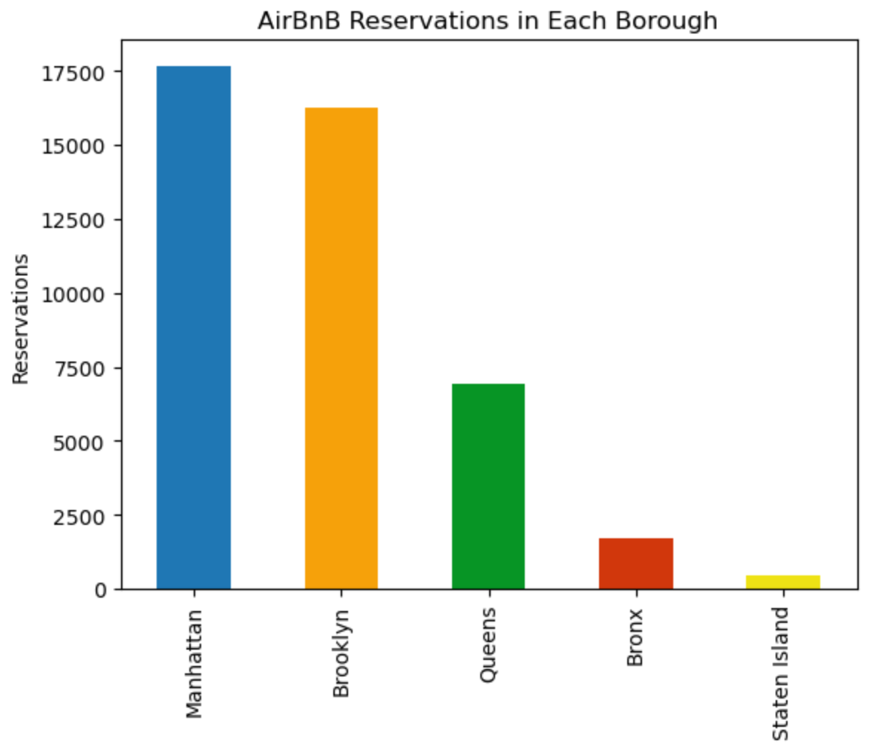

Slide 9
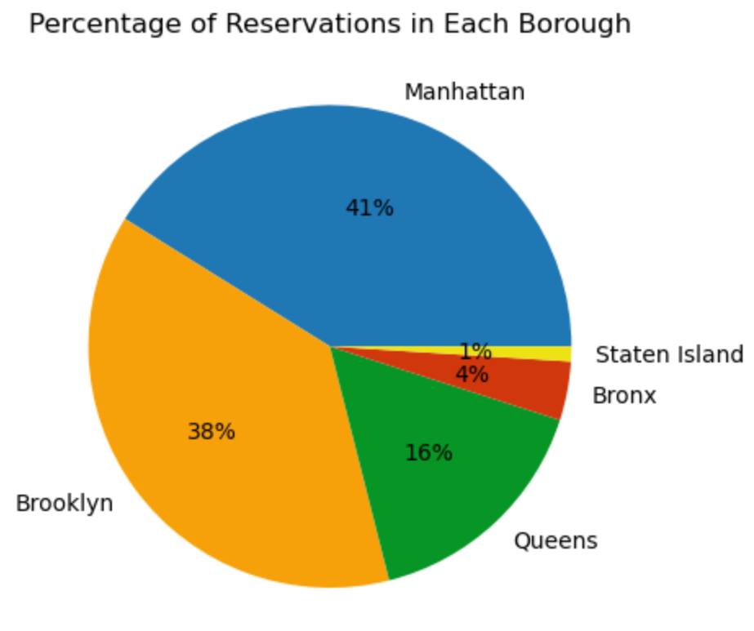

Slide 10
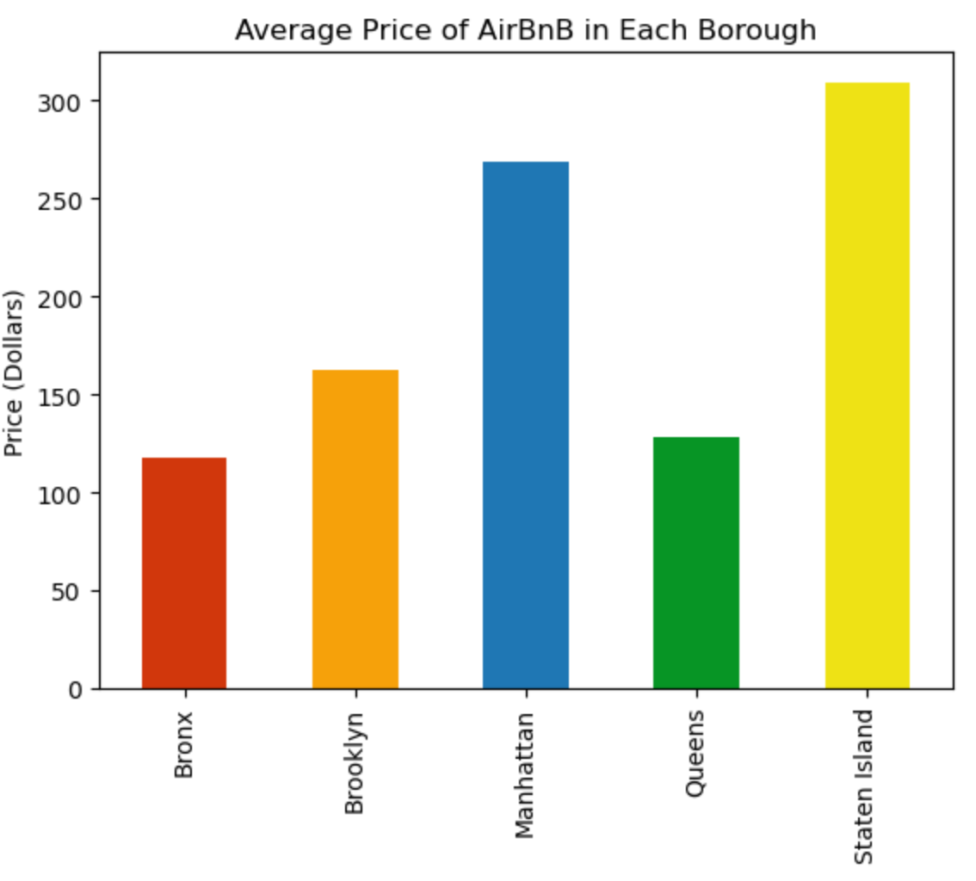

Slide 11
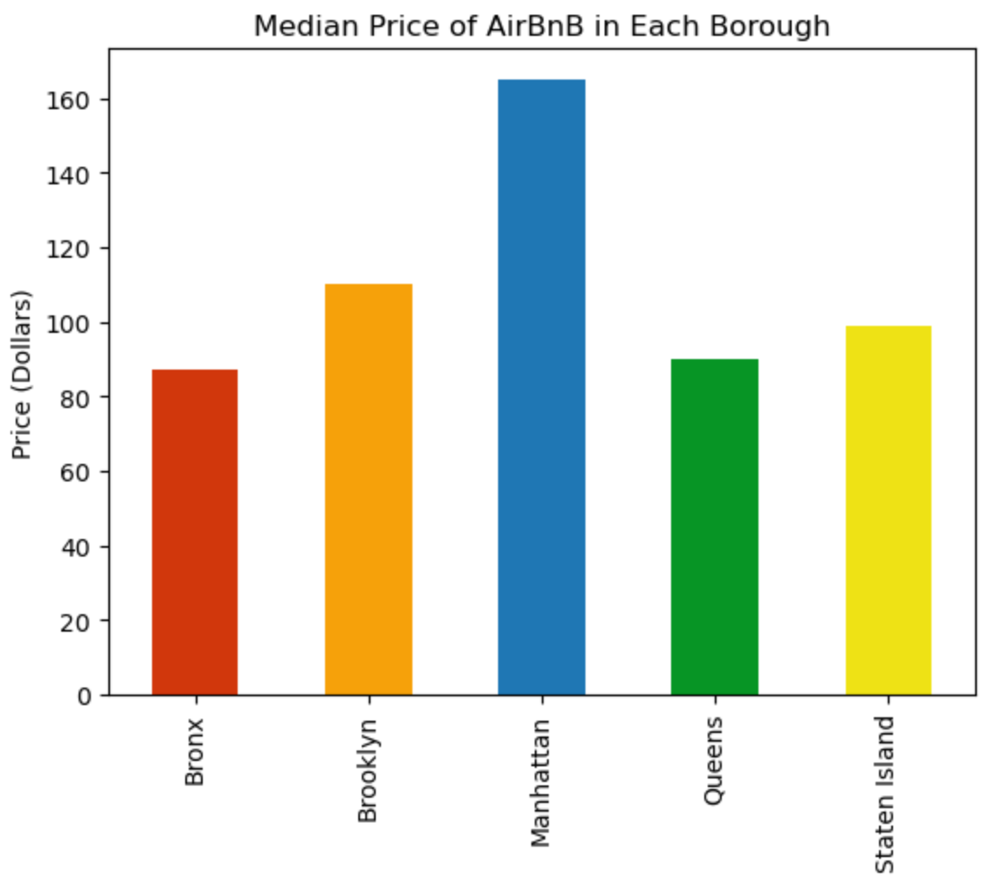

Slide 12
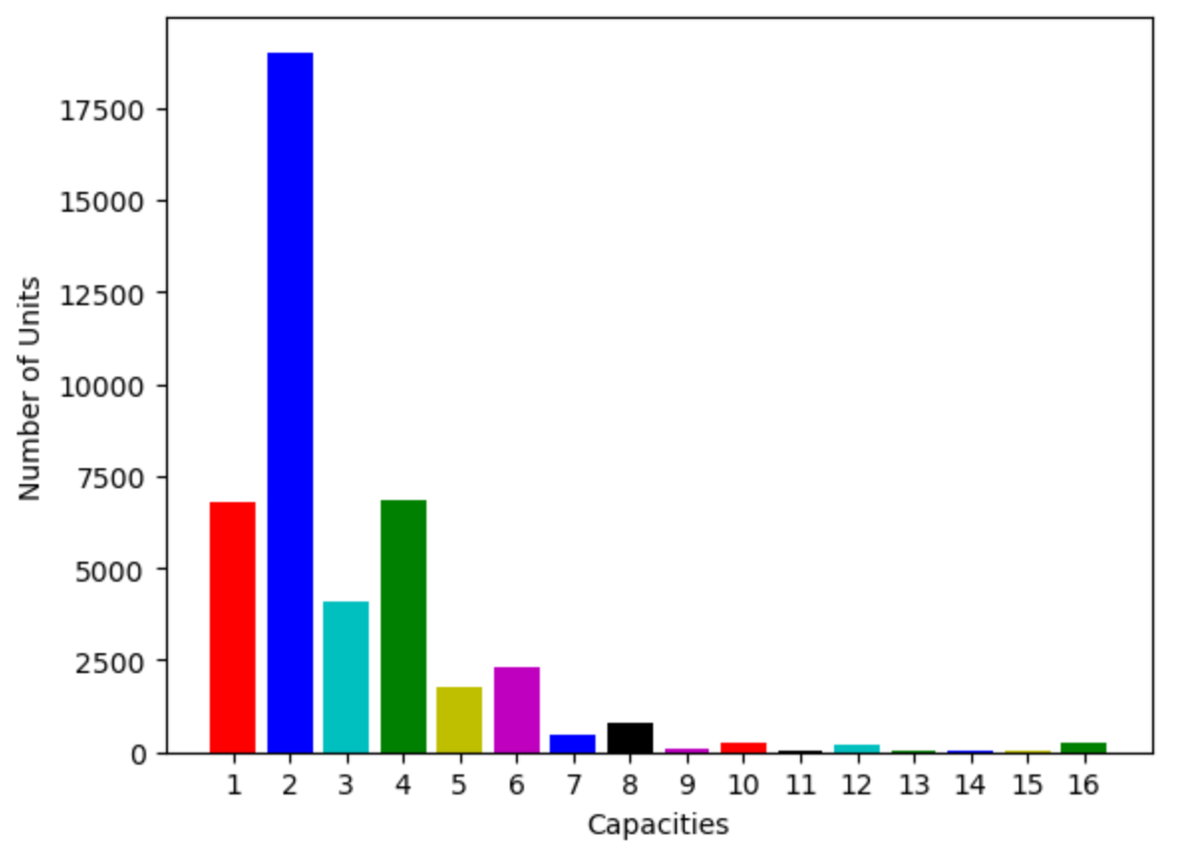

Slide 13
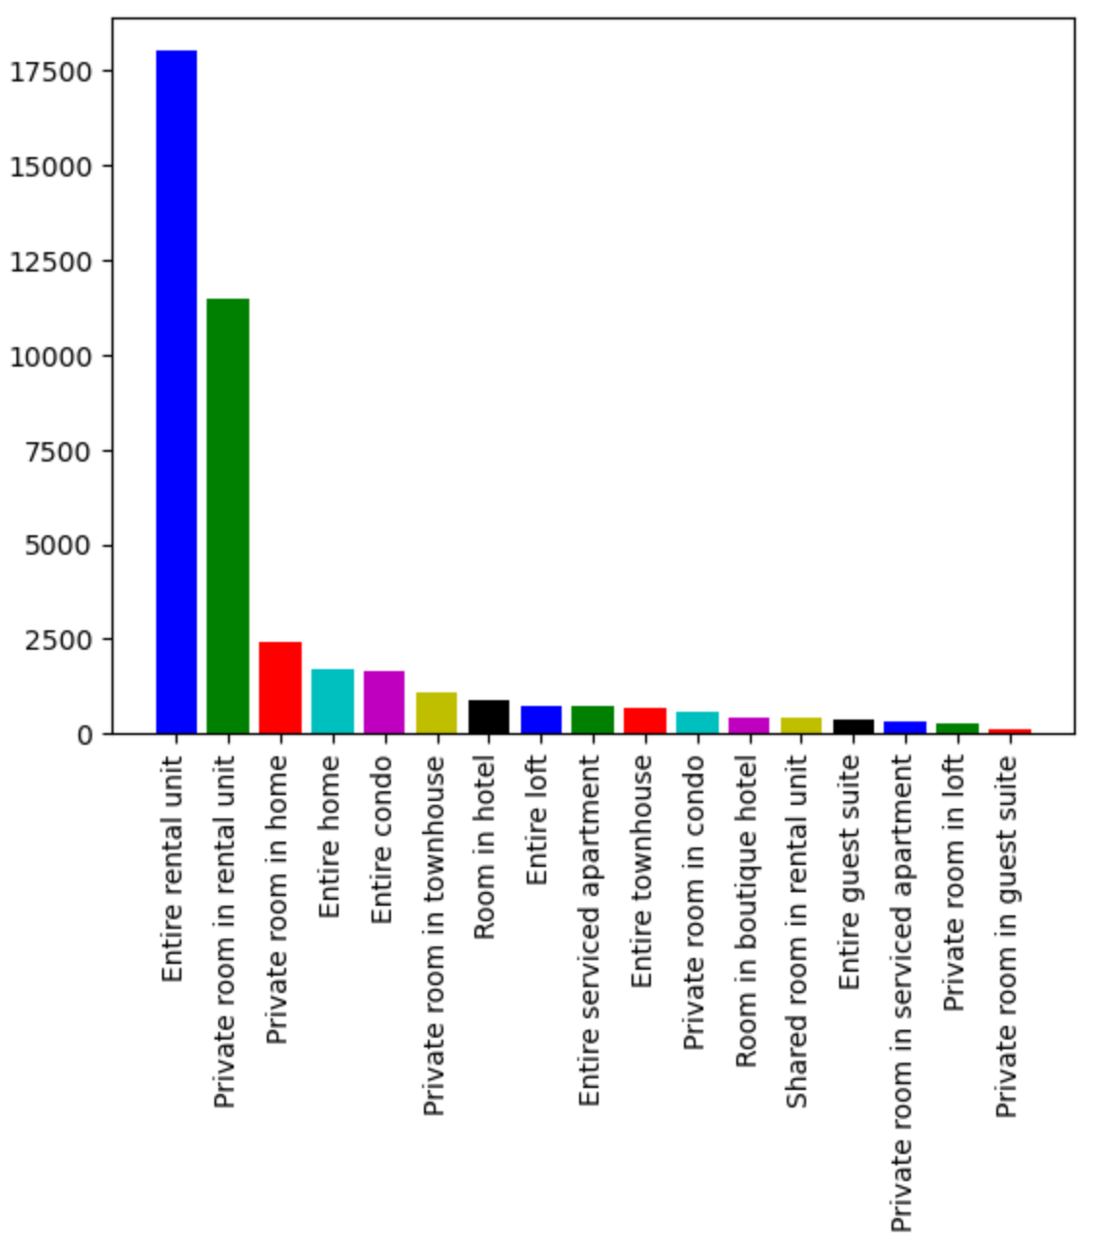

Slide 14
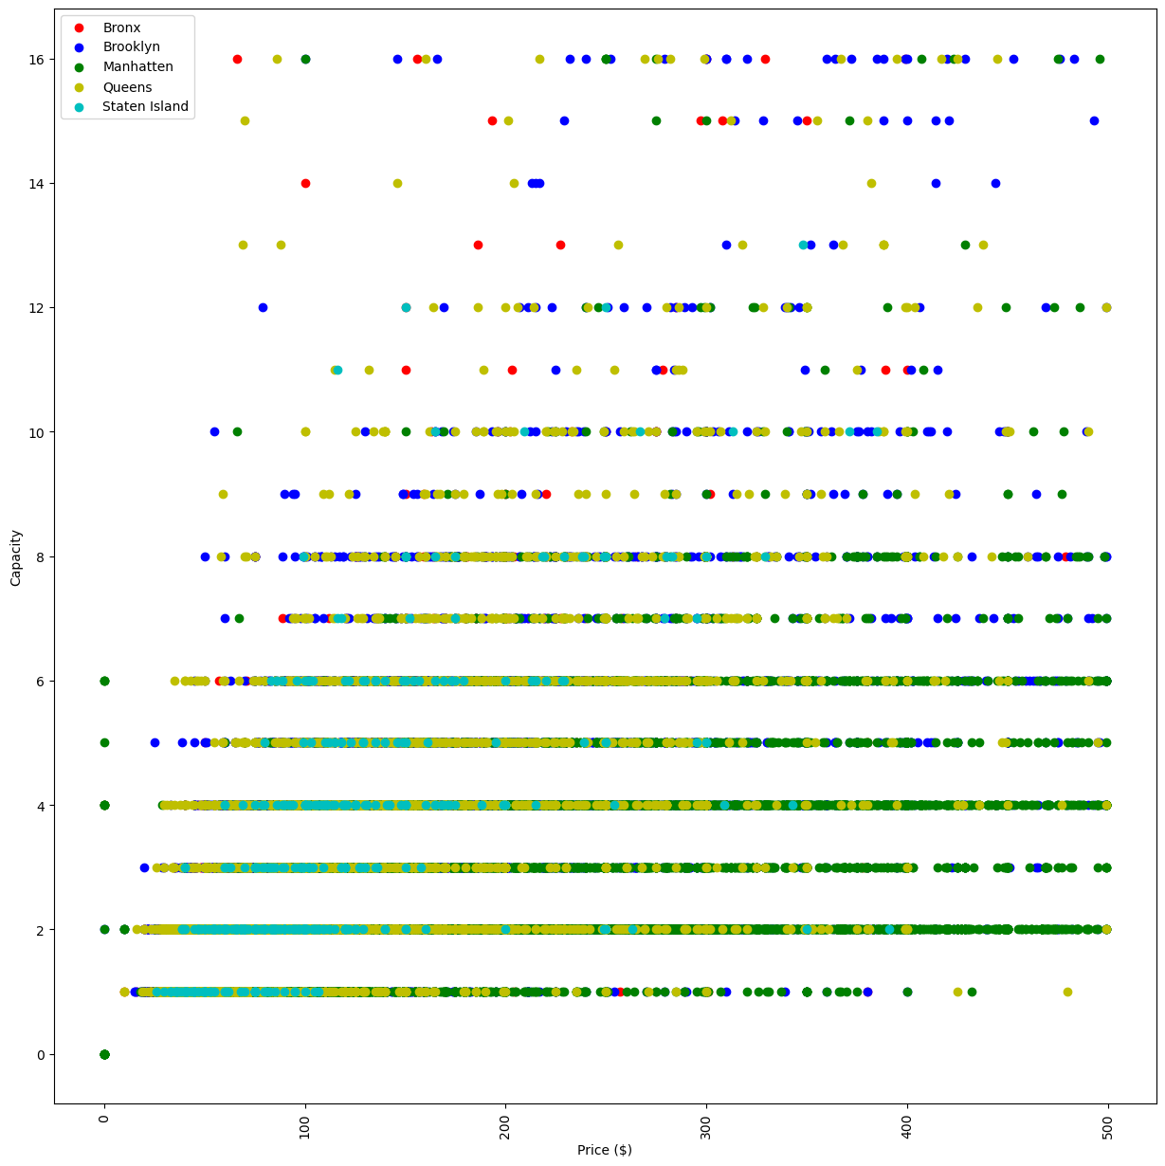

Slide 15
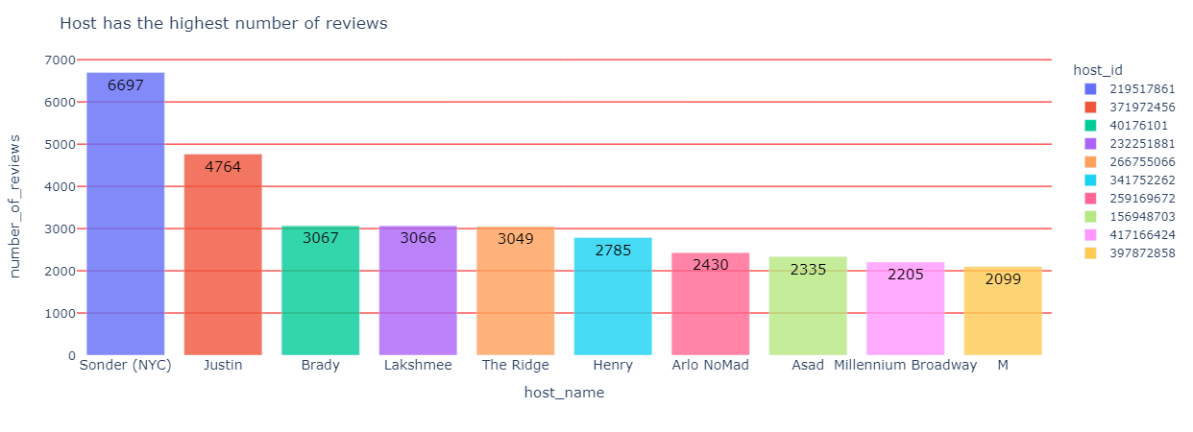

Slide 16
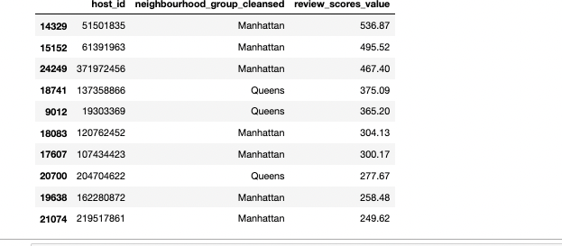

Slide 17




Conclusion

Slide 18

Thank you
Source:
“New York City.” Inside Airbnb, 6 Mar. 2023, http://insideairbnb.com/get-the-data.

